Slide 1
529 Data Analytics
March 8, 2015
HDI Data Regression Analysis
Sukanya Nagarajan

Slide 2
Table of Content
Business Scenario:
HDI Determination for United Nations
Business Objective
Selected Data:
HDI Source Data Details
Data Activities:
Data Cleansing
Exploratory Data Analysis Result:
HDI vs (Education Index, Life expectancy, GNI)
Correlation- HDI Vs Education Index
Correlation- HDI Vs Life Expectancy at birth
Correlation- HDI Vs GNI
Regression Modeling Results
Model Fit Check for HDI vs Education Index
Analysis-HDI vs Education Index
Model Fit check-HDI vs Life Expectancy at birth
Analysis-HDI vs Life Expectancy at Birth
Comparison: Education Index Vs. Life Expectancy
Conclusions
United Nation HDI

Slide 3
Business Scenario: HDI Determination For United Nations
United Nation Development Program wants to increase the Human Development Index for the United Nations , which is the assessment of the development of the country based on the capability of people.
United Nation was in the 1st position years before and now stands in the 8th position based on HDI, the officials in the research is given the task to determine the factors influencing the HDI decline and suggest improvements in the factors so United Nations will move to the 1St position.
The research department decide to build models that would predict those indices that lead to decline in HDI and help improve the same.

Slide 4
Business Objective:
Improve the Human Development Index (HDI) of United Nations.
This will be addressed by building models to identify those Indices that contribute to the decline of the HDI.
The indices that were analyzed are
Life expectancy at birth
Education Index ( The average of expected years of schooling and mean years of schooling)
GNI (Gross National Income per capita)
Once the variable that influence the HDI are determined, the level of influence will be found and improvements to the HDI will be decided.

Slide 5
Selected Data: HDI Source Data Details
There are 195 countries participating in the HDI dataset, there is data from 2010 – 2014
Human Development Index and its components – The data contains the HDI rate for each country and other variables.
Response Variable- The HDI is the response variable, for which we will determine the influence for using predictor variables.
Predictor Variable– The variables that will be used to determine the HDI are the predictors,
Education Index (derived as the average of Mean years of schooling and Expected years of schooling)
Life Expectancy at birth
Dataset Source Link is
http://hdr.undp.org/en/data
Download the Following from the link above
Humane Development Index and its component (Table1)
There were 4 variable considered out of which only the Education Index and Life expectancy at birth has influence on the HDI. Other variables not considered are as follows
HDI Rank (categorical)
Country (Text)

Slide 6
Data Activities: Data Cleansing
Some under-developed countries( countries that have lower HDI comparatively, and hold a HDI rank are categorized as Under-developed, Medium HDI valued countries are Developing countries and Higher HDI valued countries are Developed countries)did not have the life expectancy at birth value, a value of “0” indicates that the value was missing.
There were no negative values, the data from 2010-2014 were consolidated into a single file for easy processing.
Outliers from the linear regression were removed, for accurate values.

Slide 7
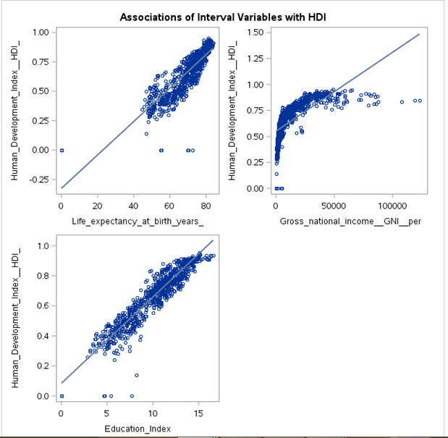
Exploratory Data Analysis Result: HDI vs (Education Index, Life expectancy, GNI)
The relationship between the HDI and Life expectancy at birth years and relationship between the Education Index and HDI is linear.
Whereas, the relationship between the GNI and HDI is curvi-linear in relationship. That is, the GNI increases vertically, reaches a threshold, then increases horizontally.
There appears to be a strong relationship/influence on HDI by the Education_Index and the Life expectancy at birth years variable compared to GNI.
The GNI is more skewed towards higher values and concentrated towards lower values.

Slide 8
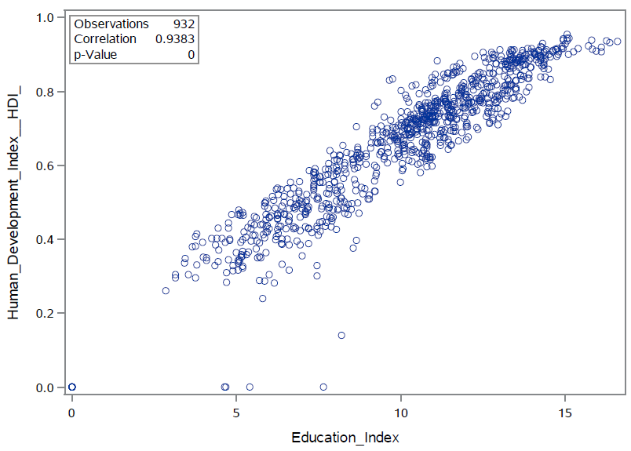
Exploratory Data Analysis Result: Correlation- HDI Vs Education Index
The relationship between Education Index and Human development Index (HDI) is positive, increase in education Index gives a proportional increase to HDI.
Education Index has a perfect positive Correlation/Influence with p-value <0.0001 and correlation of 0.9383.
The smaller p-value indicates a stronger evidence against null hypothesis, so rejected the null hypothesis. That is, there is no variation that exist between the HDI and Education Index, hence this variable can have stronger influence over HDI.

Slide 9
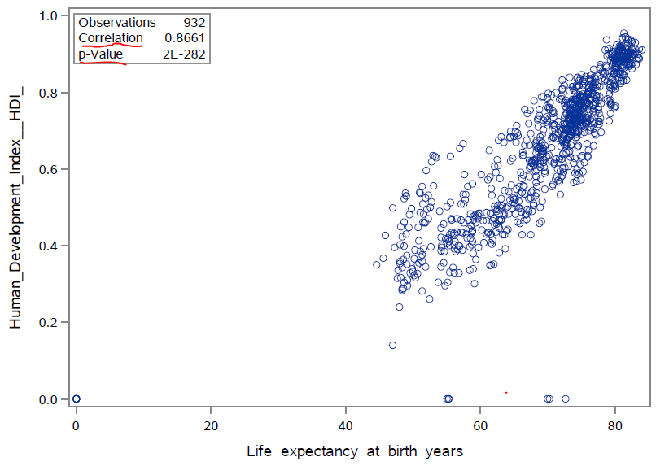
Exploratory Data Analysis Result: Correlation- HDI Vs Life Expectancy at birth
The relationship between Life Expectancy at birth and Human development Index (HDI) is positive indicates a increase in life expectancy, increases HDI.
Life Expectancy has a perfect positive Correlation/Influence with p-value <0.0001 and correlation of 0.8661.
The p-value is smaller but not 0, but Education Index has a p-value of 0. Hence Education Index has stronger influence over HDI than Life expectancy at birth.
The higher the life expectancy the higher is the HDI and life expectancy is more concentrated towards higher values.

Slide 10
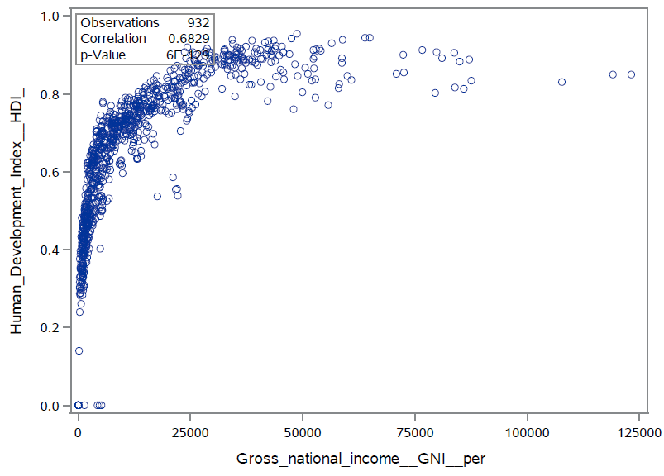
Exploratory Data Analysis Result: Correlation- HDI Vs GNI
The GNI and HDI have strongly positive curvi-linear relationship.
Though GNI has a positive influence, it does not appear to fit into a model of Linear relationship, only a non-linear relationship can exist.
For Non-linear relationship, p-value prediction will be difficult and the influence of this predictor over the response will be less intuitive to understand.
Hence GNI will not be considered for the response variable influence though it has a p-value of 0.68290 for a linear model. GNI might not give exact results for a linear fit model.

Slide 11
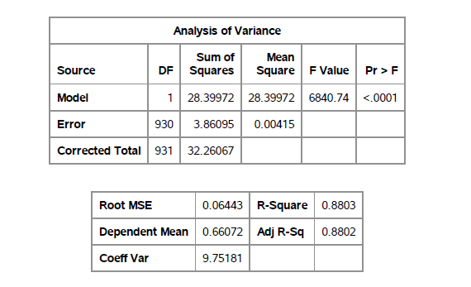
Regression Modeling Results: Model Fit Check for HDI vs Education Index
The regression analysis model has better fit for the HDI data. The F-test is statistically significant , which means the model is significant.
R-squared is 0.8803 means that approximately 88% of the variance of HDI is accounted for by the model, here Education Index.
The Error and Corrected total do not have much difference, indicates a better fit of the model.
Significant fit indicates a good relationship between the response and the predictor variables and the equation to contain less error factor.

Slide 12
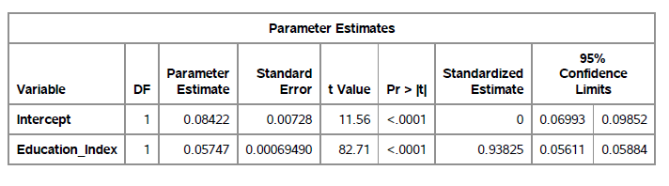
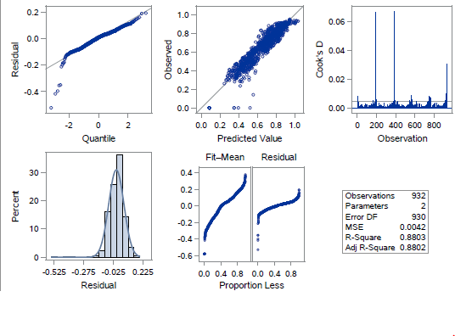

Regression Modeling Results: Analysis-HDI vs Education Index
The coefficient for Education Index is 0.05747, which means a increase in Education Index by 1 year, the HDI values can be expected to increase by 0.05747.
The constant is 0.08422, and this is the predictor value when Education Index is Zero ( missing value or undefined value of Under-develop countries can have a Education Index of zero).
The data is normally distributed and the fits significantly into the regression line with few outliers in the data.
HDI variable has significant portion of variation in the model, with little residual variation. That is, there is variation of HDI which is influenced by other variables with no unexplained error(Fit-mean ,residual plot)

Slide 13
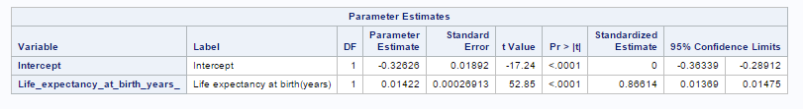
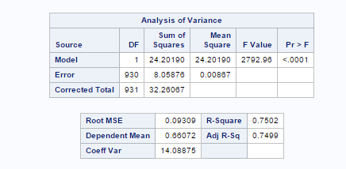

Regression Modeling Result: Model Fit check-HDI vs Life Expectancy at birth
The F-test is statistically significant but Comparatively Education Index had the most significant fit for HDI.
The R-square is 0.7502 which means that 75% of the variance in HDI accounts for the model, here life expectancy at birth.
The coefficient for Life expectancy at birth s 0.01422, an increase of 1 year in this variable has a corresponding increase in HDI by 0.01422.
The constant is -0.32626, when predictor is zero, the HDI is -0.32626, which can be ignored.

Slide 14
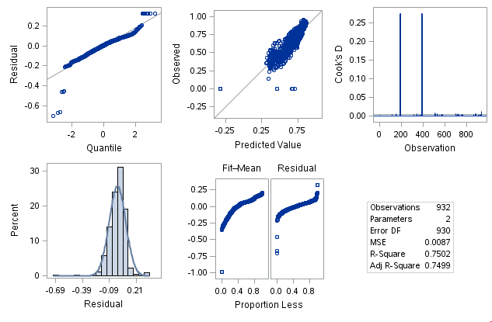
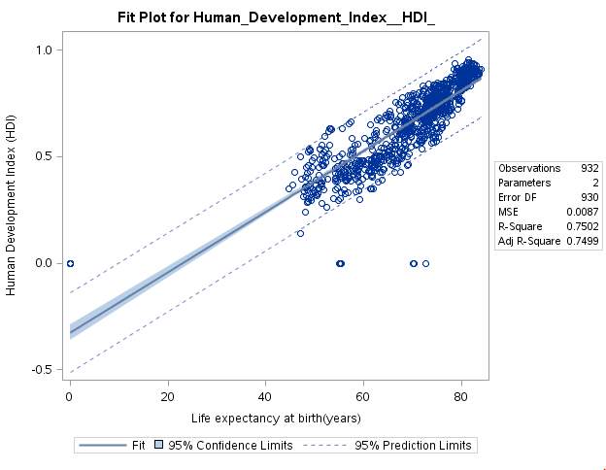
Regression Modeling Result: Analysis-HDI vs Life Expectancy at Birth
The data is normally distributed between -0.21 and 0.21.
The HDI has significant portion of variation in the model with little residual variation. The Life expectancy at birth contribute to the variance in HDI.
The data is more concentrated at higher value and more skewed towards lower values, the data is distributed normal at higher values.
The data fits into the model with few outliers, which might be due to missing values. The negative intercept is due to these missing values.

Slide 15
Comparison Education Index Vs. Life Expectancy
Coefficients | Education Index(EI) | Life Expectancy(LE)
Intercept(β₀ ) | 0.10968 | -0.32626
β₁ | 0.05528 | 0.01422
F-value | 7234.01 | 2792.96
R-Square | 0.8877 | 0.7502
t-value | 85.05 | 52.85
Correlation | 0.93825 | 0.86614
p-value | 0 | 2E-282
Equation HDI = | 0.05747 EI | 0.01422 LE
From the Table above it is clear both variable have association with the HDI response variable. Education Index has highest influence in determining HDI compared to Life expectancy. Countries have to determine which one of these variable they have to improve to increase their HDI in order to move to a higher rank.

Slide 16
Conclusions: United Nation HDI
The Equations to determine the HDI are
HDI = 0.05747 * Education_Index
HDI = 0.01422 * Life_expectancy_at_birth
Education Index has 88% influence on HDI while Life Expectancy has 75% influence on HDI. There were other variable of which only these two had significant influence over HDI.
Life expectancy at birth is considerable good for United Nations compared to other countries, it is the Education Index that contribute to the decline in HDI, so improvement to Education Index for United Nations will improve its HDI, moving to 1st position.
United Nations present HDI is 0.91, to move to 1st position (0.94), Education Index should be greater than or equal to 16.35 (now 14.7) which has the highest influence on HDI, to move to the first position.
Life Expectancy at birth(in range 50 – 82, USA 79.1) can be increased over time by changing life style, creating awareness towards health concerns, but does not guaranty tremendous increase in value. Hence Education Index is the best factor for short-term goals.

